Slide 1
An Investigation into How Best to Represent a 3D Cross Section of 4 Dimensional Objects
Joe Subbiani

Slide 2
Presentation Structure
What is the 4th Dimension
How to view the 4th Dimension
Building 4D Shapes
4D Rotation
Extensions to a 3D cross section
The Experiment
The Results

Slide 3
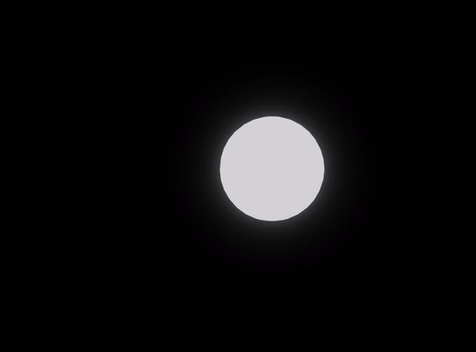
What is the 4th Dimension Structure

Slide 4
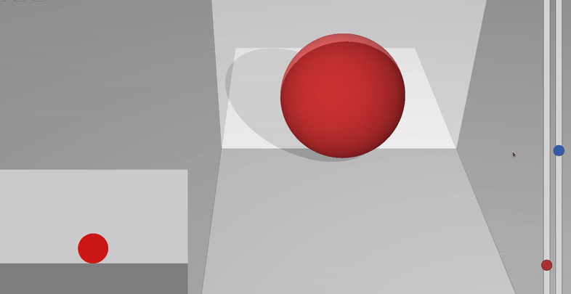
Taking A 3D Cross Section
How to view the 4th Dimension

Slide 5
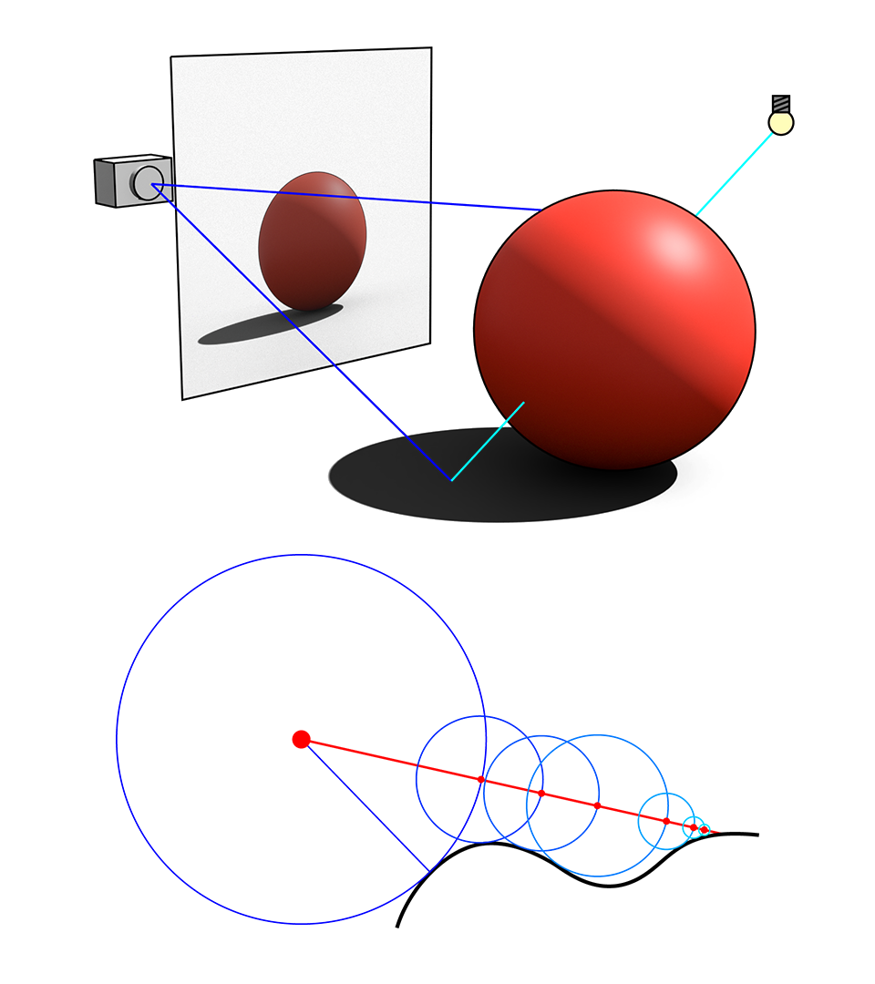
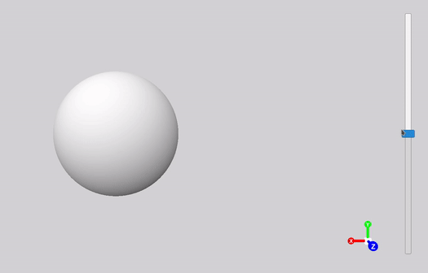
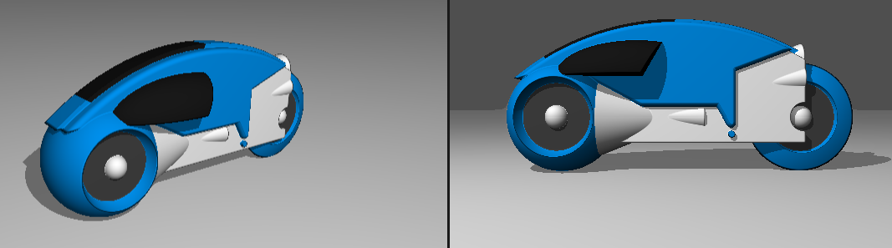
Ray Marching
Building 4D Shapes
Ray Marched 3D cross section of a 4D hypersphere
Personal Ray Marching Experiment in Unity
Fun Fact: The original Tron used Ray Marching!

Slide 6
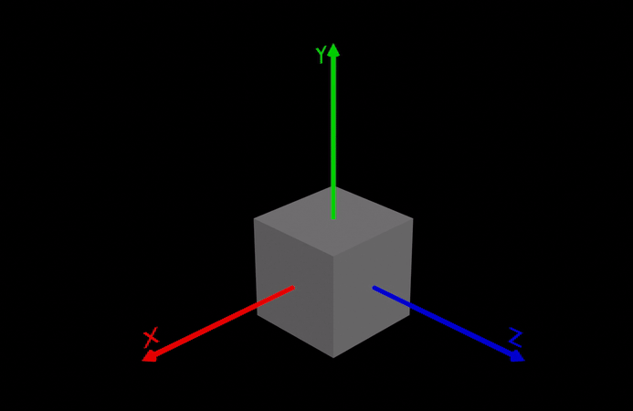
Rotating About a Plane
4D Rotation
Why leave the dimension to perform the rotation?
Planar rotation stays within the dimensions of rotation

Slide 7
The Rotor
4D Rotation

Slide 8
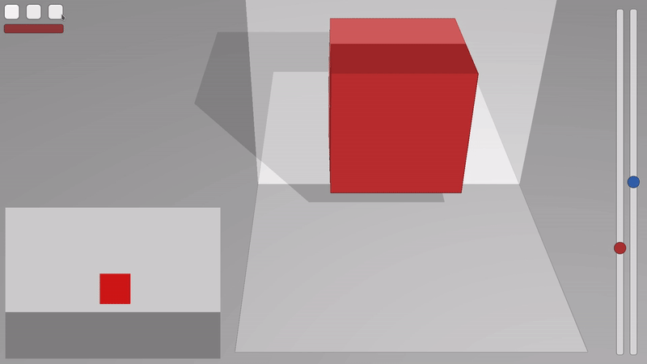
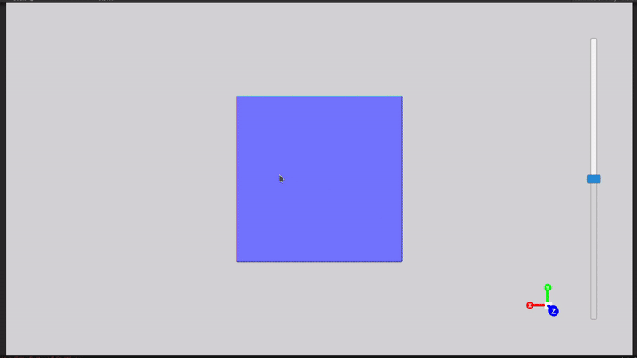

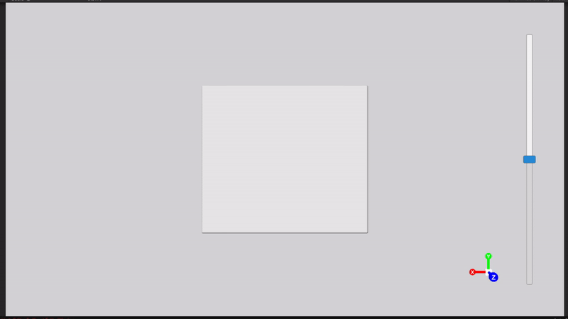
4D Rotation - 2D 3D 4D
2D Cross Section of 3D Object
3D Cross Section of 4D Object
Rotation within dimensions
Rotation outside of dimensions

Slide 9
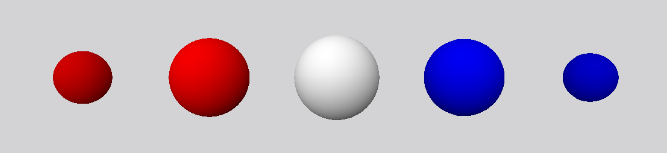
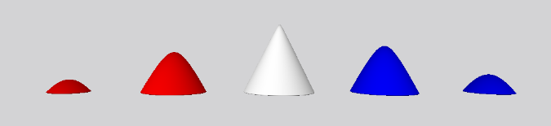
W-Axis “Timeline”
Extending a Cross Section of a 4D Object

Slide 10
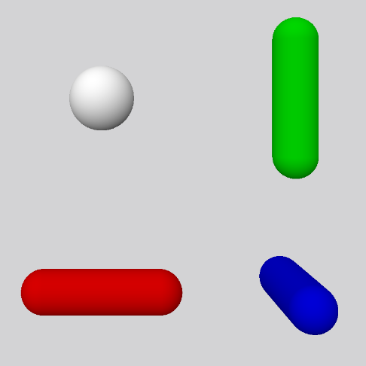
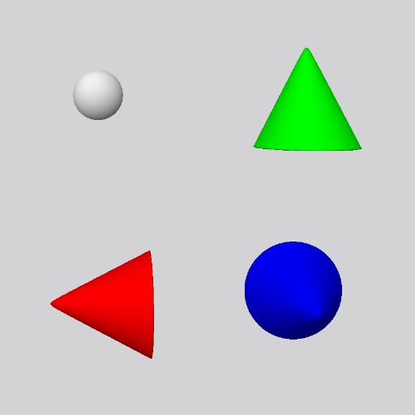
Multi-Rotational Views
Extending a Cross Section of a 4D Object
All 2D 90⁰ cross sections of a 3D Cylinder

Slide 11
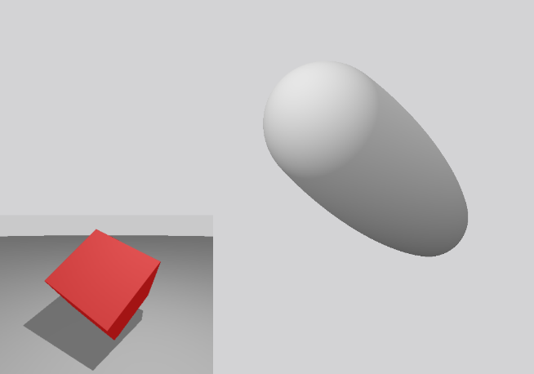
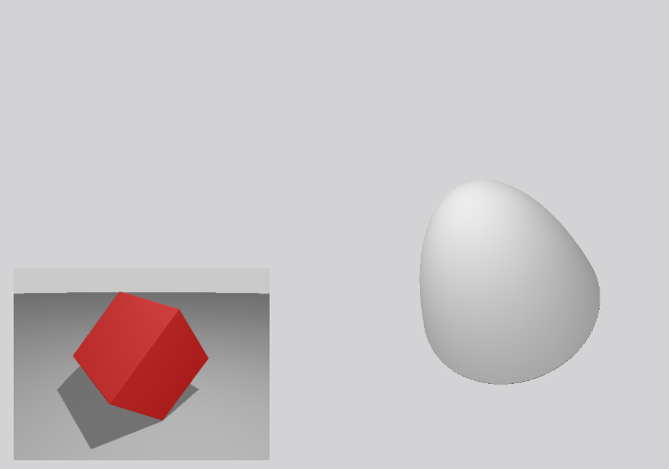
3D Axial Rotations on the 3D Component of a 4D Plane of Rotation
Extending a Cross Section of a 4D Object

Slide 12
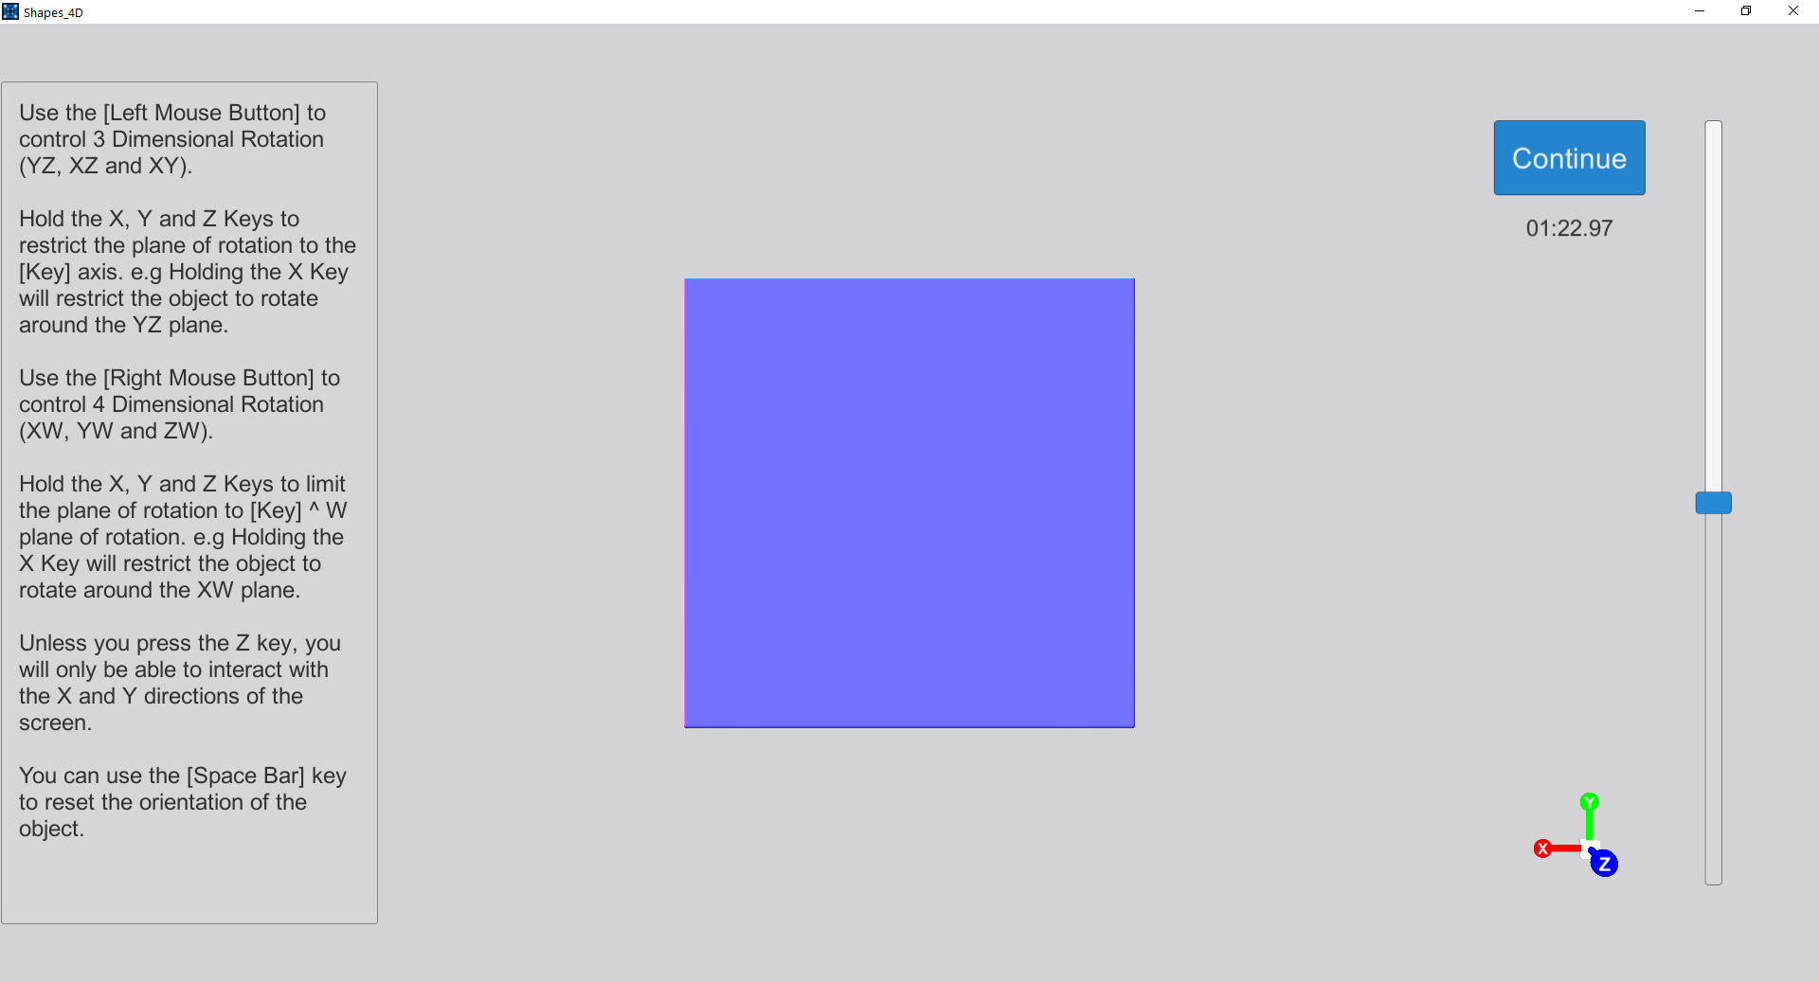
The Experiment
Challenging – time vs data
May have been too short for users

Slide 13
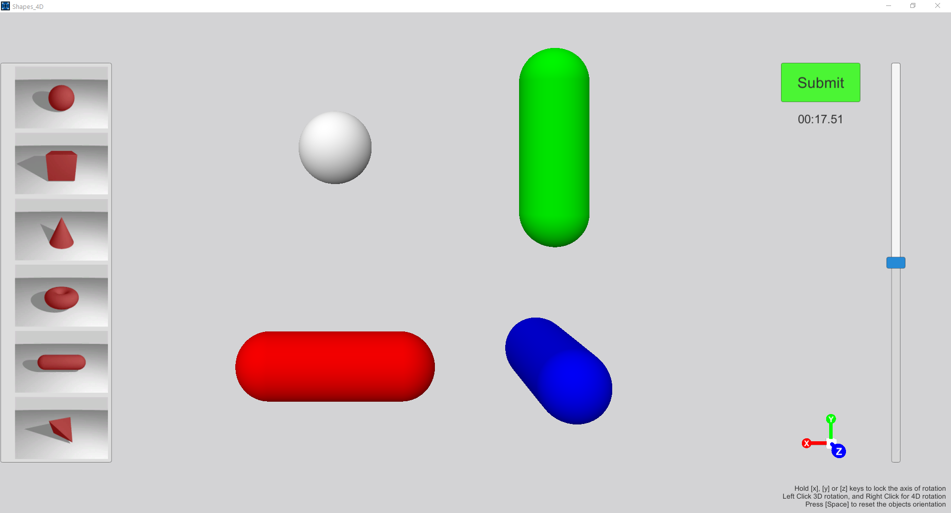
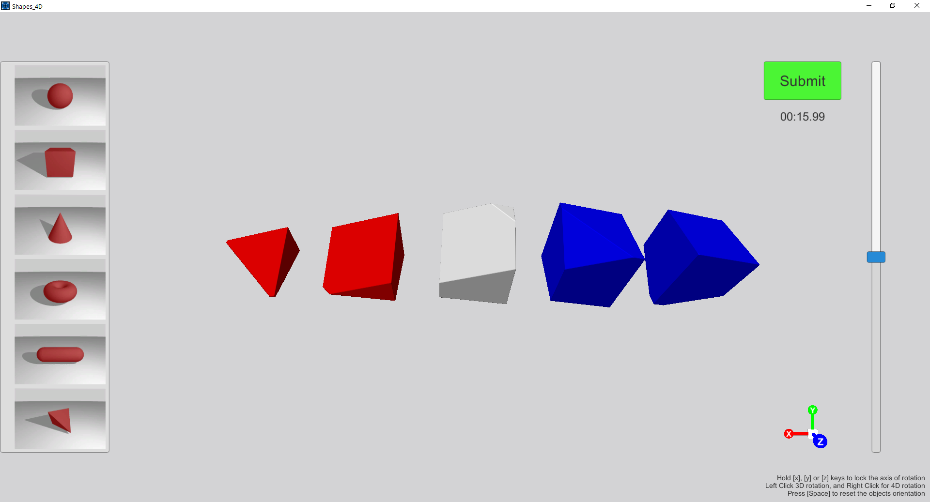
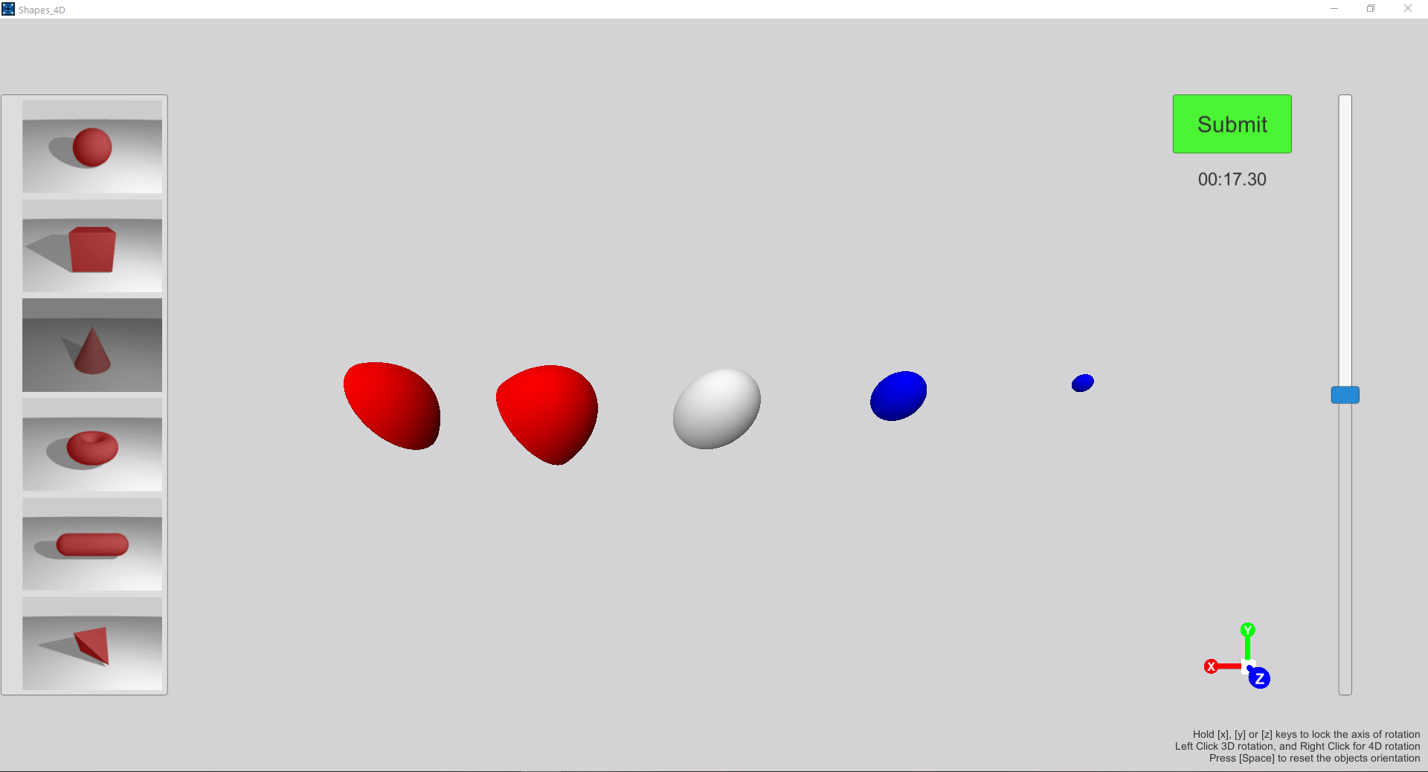
Shape Matching
The Experiment

Slide 14
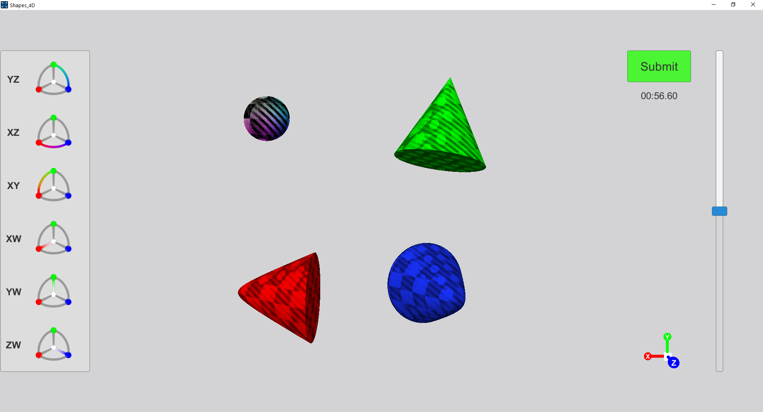
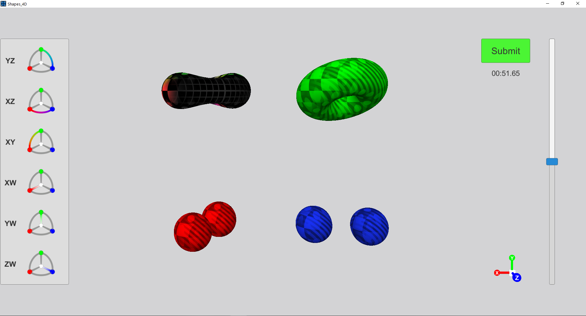
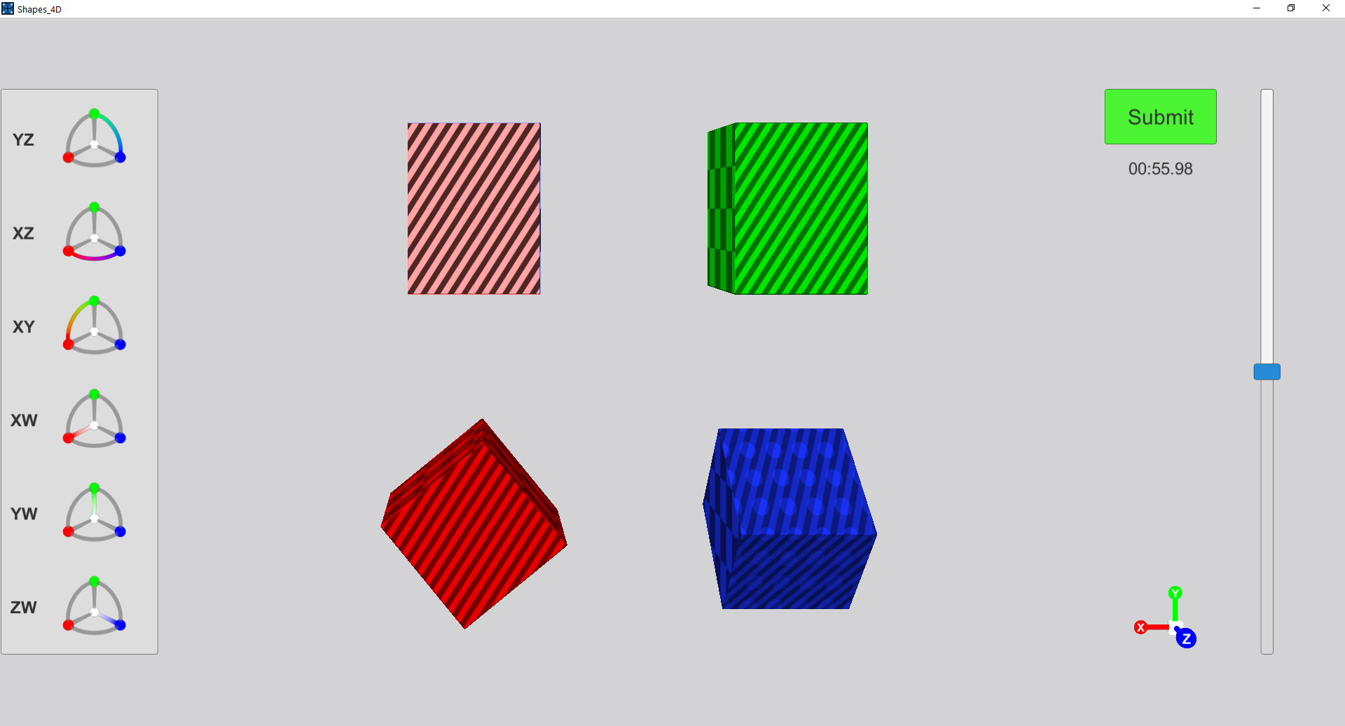
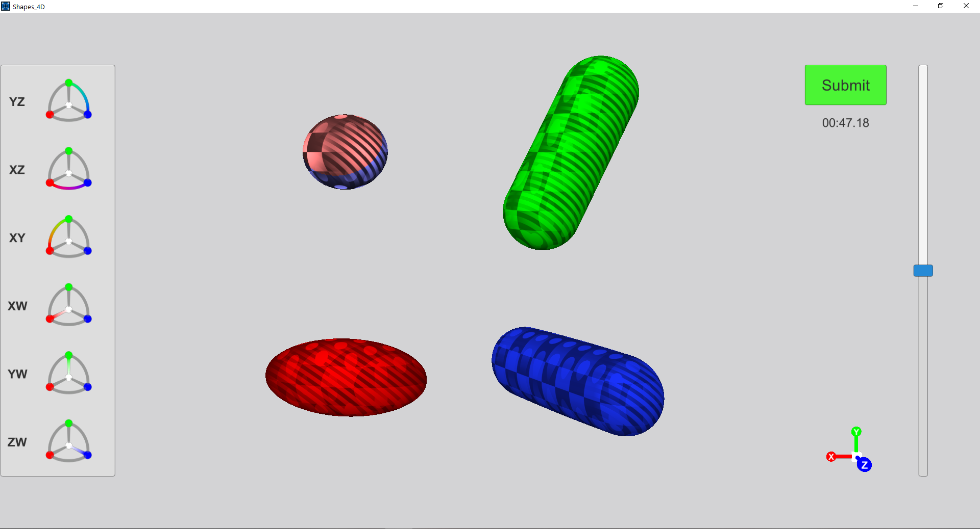
Rotation Matching
The Experiment

Slide 15
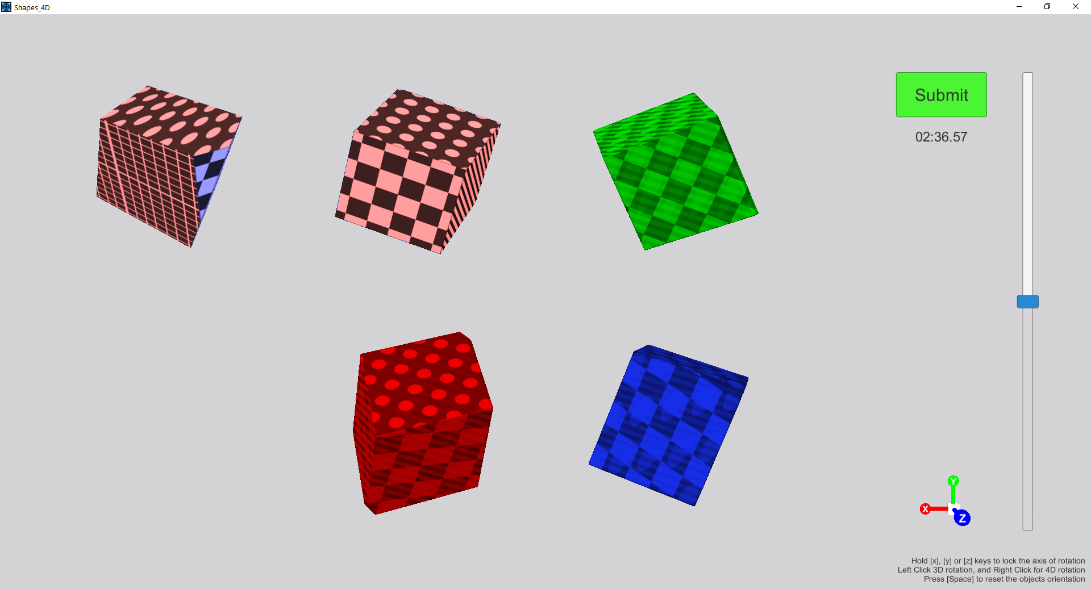
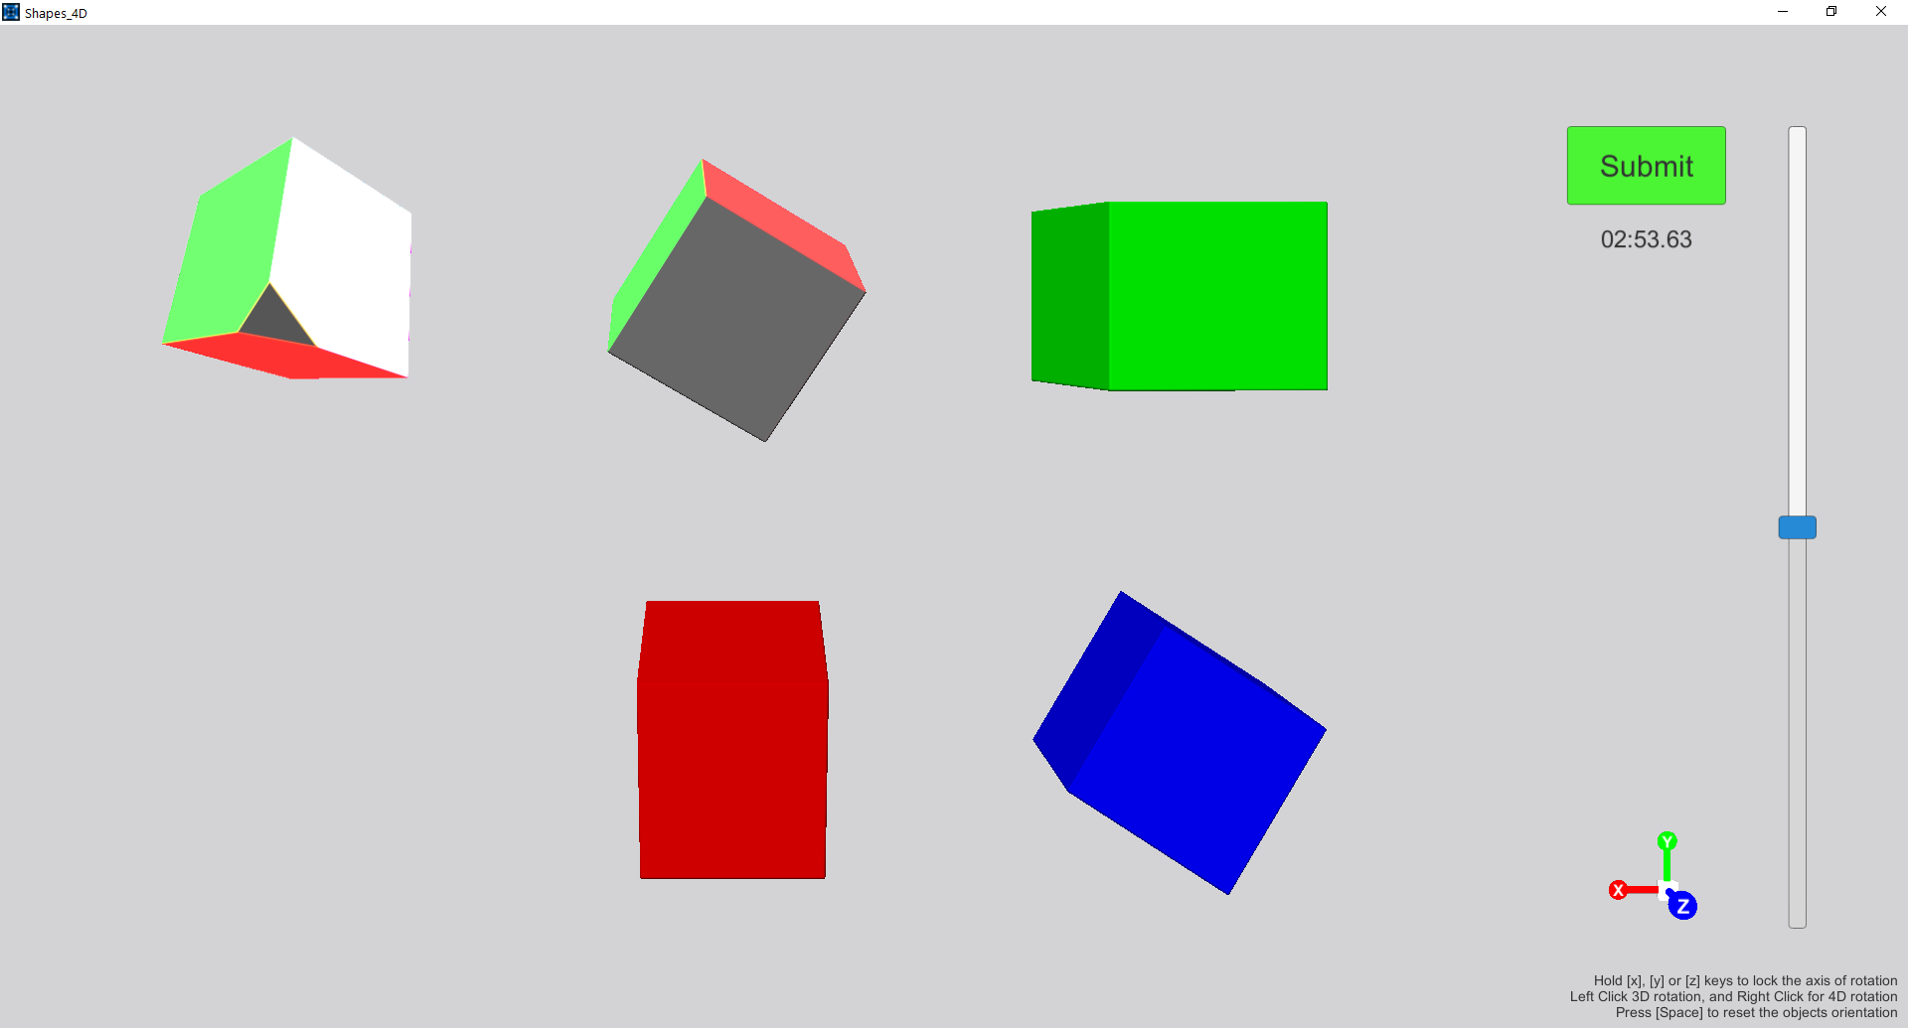
Pose Matching
The Experiment

Slide 16
The Results

